Slide 1

Shopping Assistance for Visually Impaired People
Jaypee Institute of Information Technology, Noida
Submitted By:
(Group 4)
Gargi Gupta M.Tech CSE
Stuti Gupta M.Tech DA
Kumar Satyajeet M.Tech CSE

Slide 2
Problem Statement:
Vision loss is one of ultimate obstacle in the lives of blind that prevent them to perform tasks on their own and self-reliantly.
They are bound to depend upon on their family for assistance, who often may not afford quality time due to busy routine.
The thought of dependency rises lack of self-confidence in blinds, absorbs their ability to negotiate, decision making power, and social activities.

Slide 3
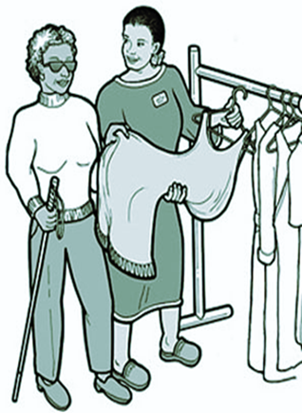
The estimated number of people visually impaired in the world is 285 million, out of which 39 million are blind and 246 million having low vision.
“You always have to find someone at the store to help you,” says Michelle McManus, president of the Happy Valley, Pennsylvania, chapter of the National Federation of the Blind.
“Then you have to explain exactly what you want—and hope the person helping you is diligent about getting it right.”

Slide 4
Goals:
The project’s formal name refers to the goal of creating a process the human visual cortex, the part of our brain that processes and interprets visual information.
The system will be developed, with the intent of enabling a blind user to scan a scene with a camera and detect items on his/her shopping list.
Later , a system can be developed such that, it can be coupled to a wearable device that will help visually impaired people do their grocery shopping, find their belongings or the things lying in front of them easily.

Slide 5
Background Study:
Object Detection is the process of finding real-world objects instances like car, flower, pedestrians etc. in still images or videos. It allows for the reorganization, localization and detection of multiple objects within an image with provides us better understanding of image as a whole.
Object Detection via Deep Learning can be done in multiple ways CNN
Image Classification is the task for assigning a label to an image. This is useful when there is a single class in the image and is distinctly visible in the image. Canonical example is classification of cat vs dog. In this project, we will use image classification based algorithms to detect objects from the gro-zi dataset.
Various image classification algorithms are: CNN, CNN-2 Layer, CNN-3 Layer, Lenet , Alexnet etc.

Slide 6
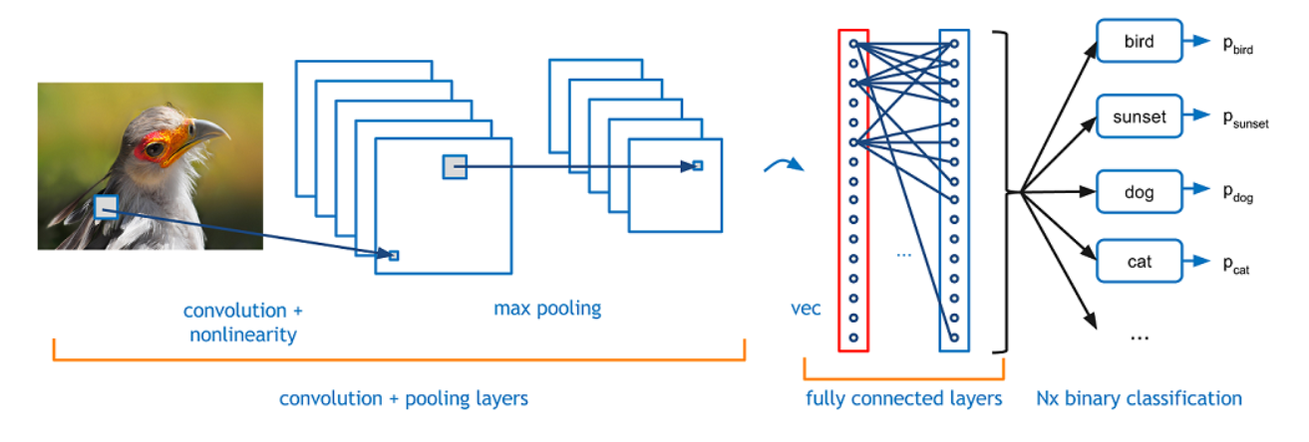
Convolutional Neural Network(CNN):

Slide 7
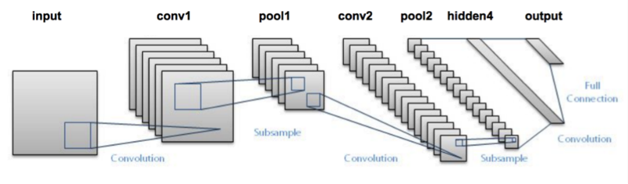
LENET:
The LeNet architecture is an excellent “first architecture” for Convolutional Neural Networks.
LeNet is small and easy to understand — yet large enough to provide interesting results.

Slide 8
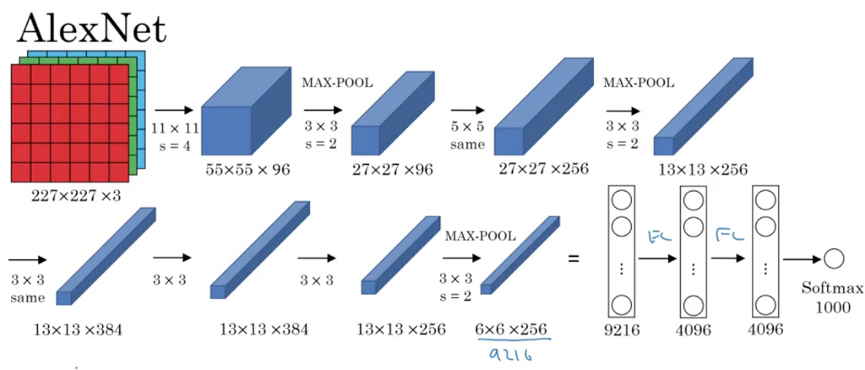
ALEXNET:

Slide 9
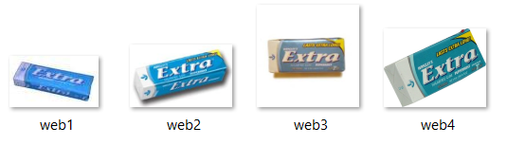

Dataset:
The GroZi-120 is a multimedia database of 120 grocery products. The objects belonging to it vary in color, size, opacity, shape and rigidity.
Every product has two different representations in the database: one captured in vitro and another in situ.
The in vitro images are isolated and captured under ideal imaging conditions (e.g. stock photography studio or a lab).
On the other hand, in situ representations come from natural environments (real world).
In Vitro
In Situ

Slide 10
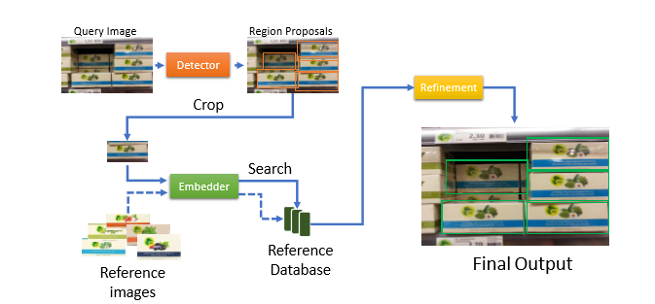
Workflow:

Slide 11
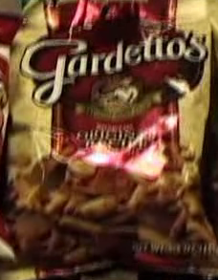

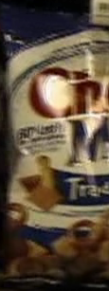


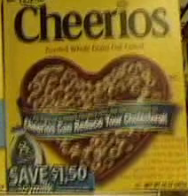



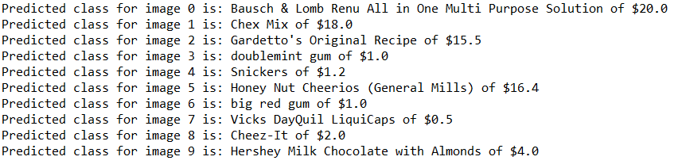
TEST CASES:
Image 3
Image 4
Image 0
Image 1
Image 2
Image 6
Image 7
Image 8
Image 9
Image 5

Slide 12
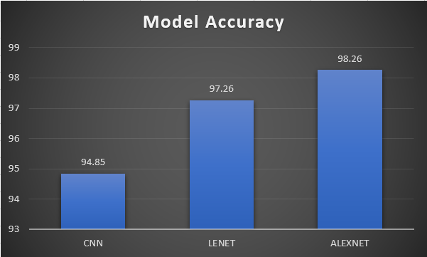
Results:

Slide 13
Thank you

